Slide 1
HARBOUR ENGINEERING

Slide 2
Harbour & Port:-
HARBOUR:-
It is partly enclosed area which provides safe and suitable accommodation for supplies, refueling, repair, loading and unloading cargo.
PORT:-
A port is a harbour where marine terminal facilities are provided.
A port is a place which regularly provides accommodation for the transfer of cargo and passengers to and from the ships.
Port = Harbour + Storage Facility + Communication Facility + Other Terminal Facility.
From above,
It can be stated that a port includes a harbour i.e. every port is a harbour.

Slide 3
WIND:-
  Wind is horizontal movement of air due to differences in air pressure which are caused by differential heating and cooling.
  In short wind means air in motion.
  Wind Characteristics:-
  Direction of wind usually specified by compass.
  Frequency of wind is the percentage of the time in a year it will blow from a particular direction.
  Intensity gives the velocity of the wind.
  Speed of wind is expressed in “knots” and wind strength is measured in kmph.
  (1 knot = 1.852 km/hr)

Slide 4
WAVES:-
  Waves are periodic undulations of the sea surface. Water waves are generated by transfer of energy from air moving over the water.
  Causes of Sea Waves:-
  Wind,
  Revolution of the earth,
  Gravitational force of the moon and sun,
  Earthquake,
  Land slide and seashore,

Slide 5
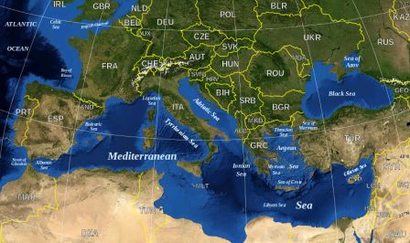
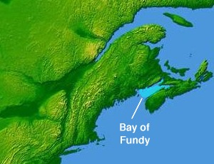
TIDES:-
  Due to gravitational force of sun and moon there is rise and fall in ocean waters called TIDES. The rise in water level is called high tide and fall in water level is called low tides.
  In Mediterranean sea, height is 0.5 to 1.0 m.
  In the Gulf of fundy, height is 15 to 20m.
Connected to Atlantic Ocean, Completely enclosed by land.
It is on the Atlantic Coast.

Slide 6
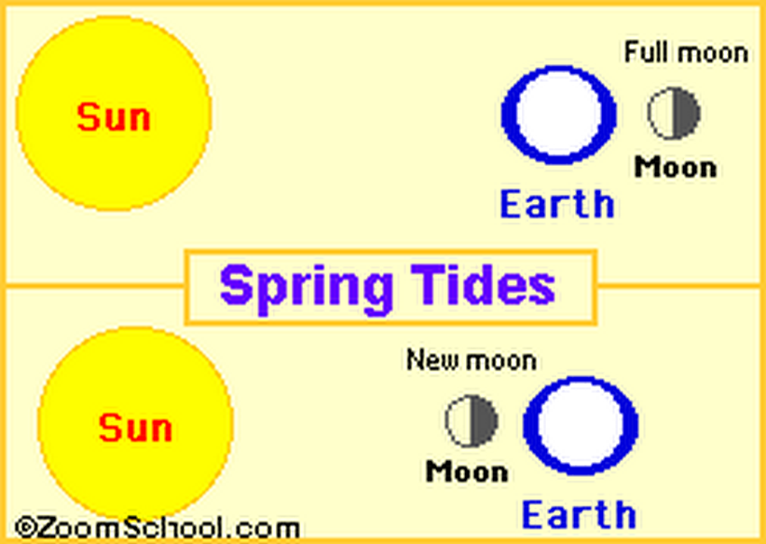
TIDES (conti….):-
  Types of Tides:-
  Spring Tide:- These are highest tides which occur when sun, moon and earth fall in line.

Slide 7
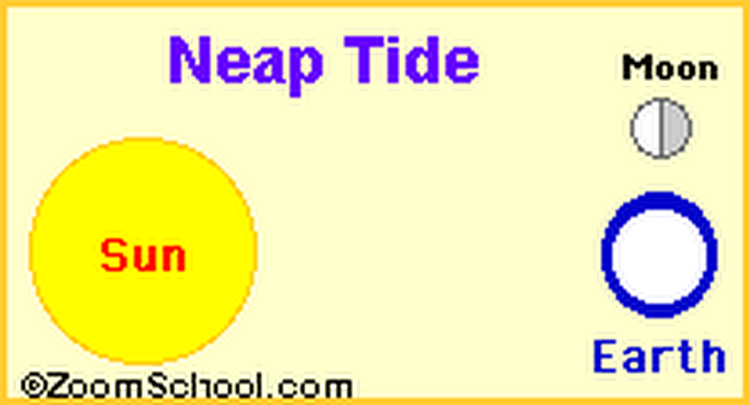
TIDES (conti….):-
  Types of Tides:-
  Neap Tide:- These are lowest tides which occur when the lines connecting the earth with the sun and the moon form right angle.

Slide 8
CURRENTS:-
  Horizontal movement of water is called current.
  Causes of Currents:-
  Tides,
  Wind blowing over ocean,
  Difference in temperature,
  Turbidity of water,
  Wave breaking at an angle of a beach.

Slide 9
CURRENTS (conti….):-
  Effects of Currents:-
  Scouring and erosion,
  Deposition(silting),
  Increase in corrosion rate,
  Delay in construction operations,
  Significant forces on marine structure,
  Loads on moored vessels.
  It is desirable that to a large extent Harbours are free from erosion and silting.

Slide 10
CURRENTS (conti….):-
  Types of Currents:-
  Primary Current
  Turbidity Current
  Tidal and Wind drift Current
  Wind stress Current
  Littoral Current

Slide 11
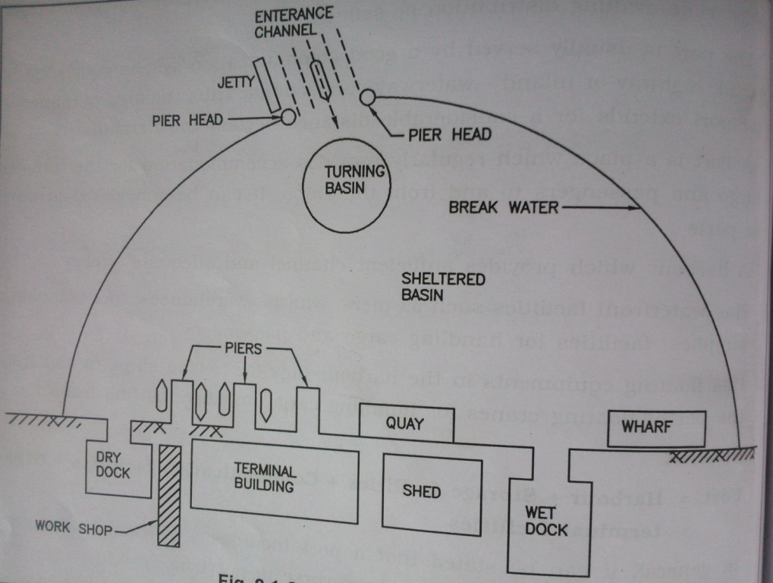
Harbour Components:-

Slide 12
Harbour Components:-
  Entrance Channel
  Break Water
  Turning Basin
  Shelter Basin
  Pier
  Wharf
  Quay
  Dry Dock
  Wet Dock
  Jetty

Slide 13
Harbour Components:-
  ENTRANCE CHANNEL:-
  Water area from which ships enter in the harbour and it should have sufficient width, 100 for small harbour, 100 to 160m for medium and 160 to 260m for large harbour.
  BREAK WATER:-
  A protective barrier made up of Concrete or Course Rubble Masonry constructed from shore towards the sea to enclose harbour .
  TURNING BASIN:-
  It is water area which is required for maneuvering the ship after entering to the harbour and it is large enough to permit free turning.
  SHELTER BASIN:-
  It is area protected by shore and breakwater.

Slide 14
Harbour Components:-
  PIER:-
  It is a solid platform at which berthing of ships on both the sides are possible.
  WHARF:-
  It is a docking platform constructed parallel to shoreline providing berthing facility on one side only.
  QUAY:-
  It is also dock parallel to the shore which is solid structure providing berthing on one side and retaining the earth on the other.
  DRY DOCK:-
  It is a chamber provided for maintenance, repairs and construction of ships. It includes walls, floor and gate.

Slide 15
Harbour Components:-
  WET DOCK:-
  Due to variation in tidal level, an enclosed basin is provided where in number of ships can be berthed. It has an entrance which is controlled by a lock gate.
  JETTY:-
  It is a solid platform constructed perpendicular to the shoreline for berthing of ships.
  QUAY:-
  It is also dock parallel to the shore which is solid structure providing berthing on one side and retaining the earth on the other.
  DRY DOCK:-
  It is a chamber provided for maintenance, repairs and construction of ships. It includes walls, floor and gate.

Slide 16
Requirements Of Good Harbour:-
  It should be connected with roadway and railway.
  Surrounding land should be fertile and densely populated.
  Ship channels must have sufficient depth for draft or vessel.
  Breakwaters must be provided to protect against destructive wave action.

Slide 17
  Requirements Of Good Harbour:-
  The bottom should furnished secure anchorage to hold ships against the wind force.
  Numbers of quay, piers and wharfs should be sufficient for loading and unloading cargo.
  It should have facilities like fuel, repair and etc. for ships.
  Harbour area should be sufficiently large.
  It should have enough cold storage.

Slide 18
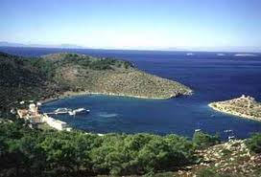
Classification Of Harbours:-
  CLASSIFICATION BASED ON THE PROTECTION NEEDED
    Natural Harbour:-
    Harbour protected by storms and waves by natural land contours, rocky out crops, or island that is called Natural Contour. (Eg. Kandla port, Cochin port & Mumbai Harbour)

Slide 19
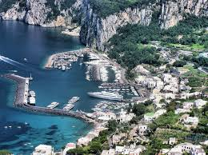
Classification Of Harbours:-
  CLASSIFICATION BASED ON THE PROTECTION NEEDED
    Semi - Natural Harbour:-
    A semi – natural harbour is protected on the sides by the contours of land and requires manmade protection only to the entrance. (Eg. Mandvi, Veraval & Visakhapatnam port)

Slide 20
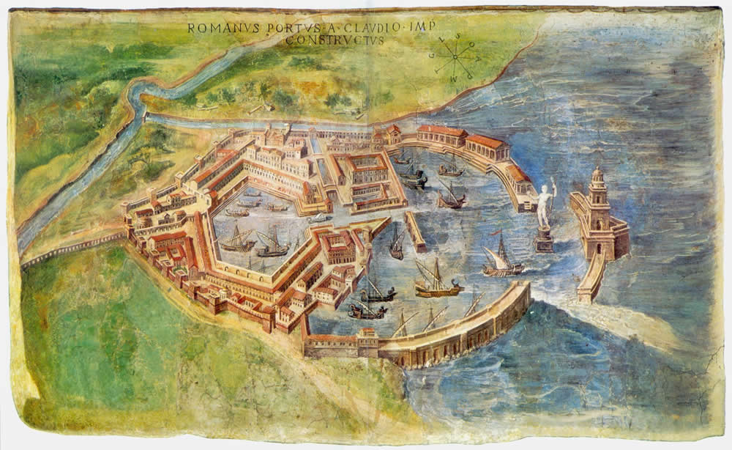
Classification Of Harbours:-
  CLASSIFICATION BASED ON THE PROTECTION NEEDED
    Artificial Harbour:-
    An artificial harbour is one which is manmade and protected from storms and waves by engineering works.
    (Eg. Chennai Harbour)

Slide 21
Classification Of Harbours:-
  CLASSIFICATION BASED ON UTILITY
    Commercial Harbour:-
    It is an harbour in which docks are provided with necessary facilities for loading and unloading of cargo.
    (Eg. Chennai Harbour)
    Refuge Harbour:-
    These are used as a heaven for ships in a storm or it may be part of a commercial harbour.
    (Eg. Chennai Harbour & Visakhapatnam Harbour)

Slide 22
Classification Of Harbours:-
  CLASSIFICATION BASED ON UTILITY
    Military Harbour:-
    It is a naval base for the purpose of accommodating naval ships or vessels and it serves as a supply depot.
    (Eg. Mumbai Harbour & Cochin Harbour)
    Fishing Harbour:-
    These harbours have facilities for departure and arrival of fishing ships. They have also necessary arrangement to catch fish.

Slide 23
Classification Of Harbours:-
  CLASSIFICATION BASED ON LOCATION
    Ocean Harbour
    River Harbour
    Canal Harbour
    Lake Harbour

Slide 24
Classification Of Ports:-
    Ocean Port:-
    This is a port intended for large ocean going ships.
    River Port:-
    River port is located on the banks of the river inside the land.
    Entry Port:-
    This is location where foreign citizens and goods are cleared through custom house.
    Free Port:-
    This is an isolated and enclosed area within which goods may be landed, stored, mixed, repacked, manufactured and reshipped without payment of duties.

Slide 25
Harbour Planning:-
    It is necessary to carry out a topography survey of the neighborhood including the foreshore and the depths of water in the vicinity.
    The borings and soundings should be taken to ascertain the character of the ground.

Slide 29
Breakwater
Definition-: This is a protective barrier constructed to form an artificial harbor with a water area so protected from the effect of sea waves as to provide safe accommodation for shipping.

Slide 30
Introduction
It is a structure which reflects and dissipates the forces of wind generated waves.
Encloses harbour and keep the harbour waters undisturbed.
It provides safe anchorage for ships
Facilitate loading and unloading of cargo in comparatively calm water
The inside of a breakwater when constructed as a quay for handling cargo then it is known as a mole.
The function of breakwater is to break the momentum of water by means of wave breaker

Slide 31
For sever wave action it is constructed of masonry
It can be made of concrete or coursed stone throughout.
Height of a breakwater depends upon its purpose, extent of enclosed water area and the nature of existing shipping work
Height=1.2 to 1.25 X the height of wave expected
The superstructure must be designed to withstand over turning forces due to wave thrust, hydrostatic pressure and the dead weight of the structure

Slide 32
Type/classification
Rubble Mound Type
Material-natural rock, concrete block, a combination of rock and concrete block, and concrete tetra pods and tri-bars, or other irregular shapes.
For durable rock foundation; rock mound breakwaters are preferred
Consist of three layers
the core-consists of quarry waste
the intermediate layer-used for protecting slopes and the top of the core-consists of rubble stones
top layer- upper portion of breakwater consists of blocks weighing 11-10 tones

Slide 33
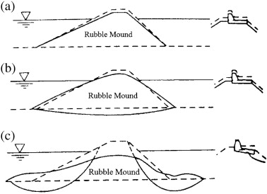

Slide 34
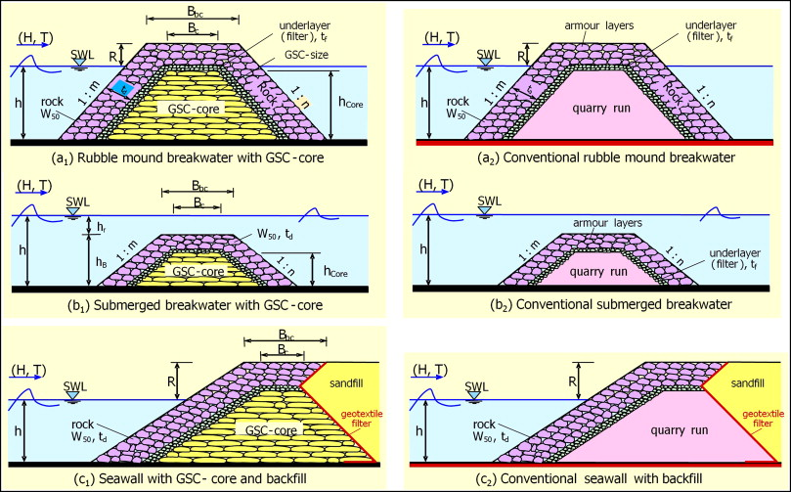

Slide 35
vertical wall type
Types of vertical wall type breakwater
concrete block gravity wall
stone and concrete masonry
concrete caissons
rock filled sheet pile cells
rock filled timber cribs
concrete or steel sheet pile walls
Suitable in following in following situation
Where depth of water is more than 2 times the maximum height of waves
when sea bed is non-erodable
where there are no chances of differential settlement of foundations

Slide 36
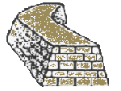

Slide 37
composite breakwater
The solid super structure consists of a quay protected by a parapet on the sea face
Provides a platform for handling cargo
It makes it possible for ships to come close to breakwater wall, on the inner or harbour side for loading and unloading cargo
It has a rubble base over which a vertical wall type breakwater is constructed
Combination of mound and vertical wall type breakwater
Recommended in locations where the depth of water is great and the foundation is of weak material
Depth of water greater than 30m

Slide 38
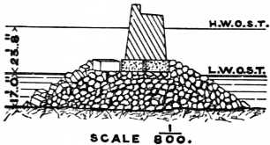

Slide 39
Wharves
These are platforms at which vessels take on and discharge passengers and cargo
It’s a platform built parallel to shoreline
Docks that parallels the shore
Should give sufficient depth of water for the ship to float
Wharves built parallel with the shore are called quays
Built to retain or protect the embankment or filling

Slide 40
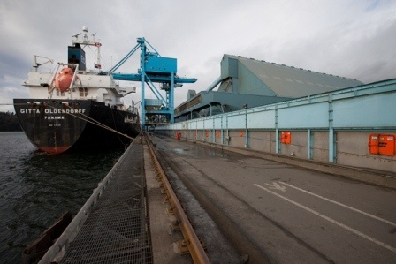
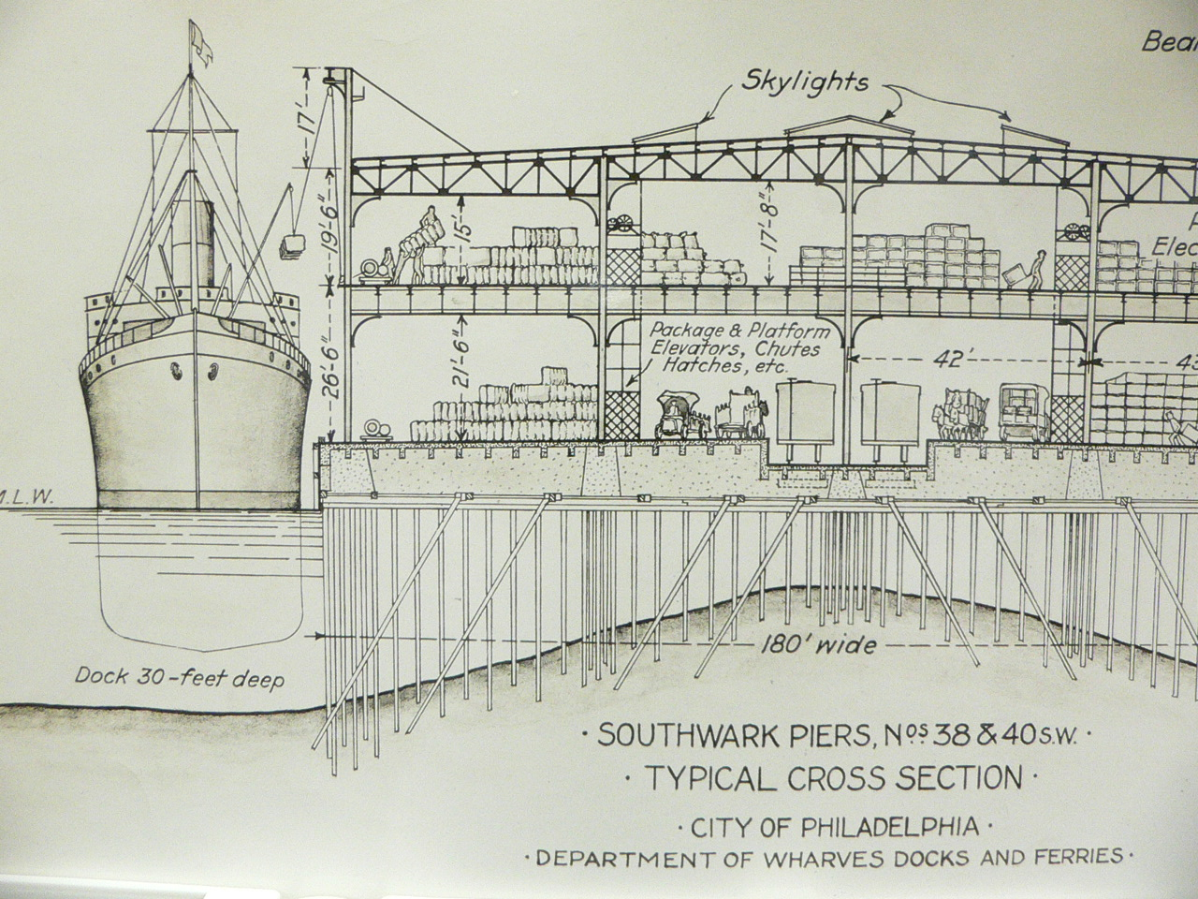

Slide 41
Types of wharves
open type wharves
It can be either high level decks or relieving type platforms
It has their decks supported by piles or cylinder
Can be made of timber, R.C.C, or both
Pre cast or pre stressed slab or beam are economical

Slide 42
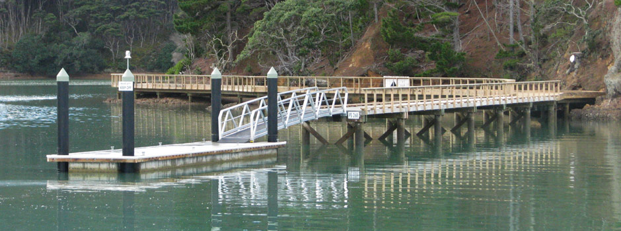
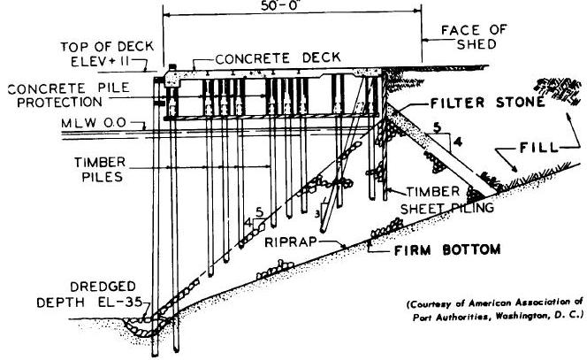

Slide 43
solid type wharves
These are composed of earth or rock fill partly confined by some sort of bulkhead
Depth less than 15m, bottom suitable for support of gravity type of structure, steel pile cells are best suited
Cells act as a gravity wall of sufficient weight
Resist over turning or sliding at base

Slide 44
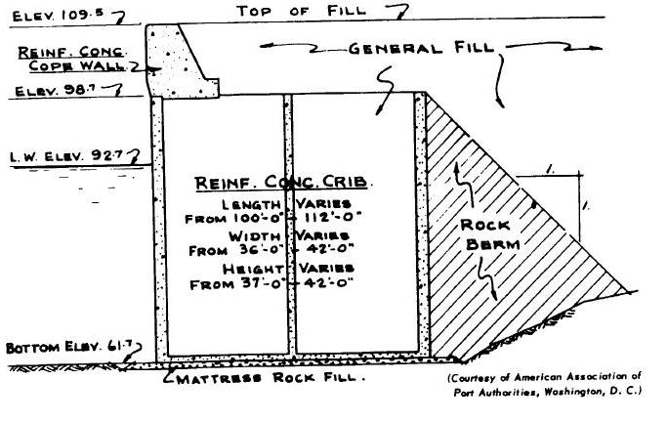

Slide 45
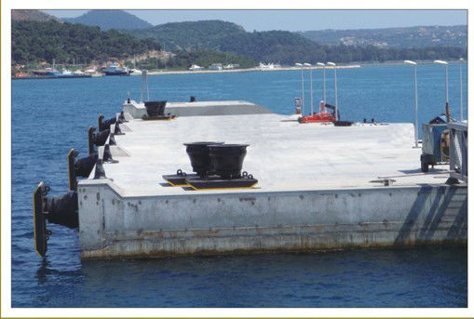

Slide 46
Quay walls
Wharves built parallel with the shore are called quays
Function-:
to retain and protect the embankment or filling on the landward side
to provide berthing on the sea side
to support the platform above

Slide 47
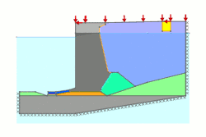

Slide 48
Jetties
Definition-:
A narrow structure projecting from the shore into water with berths on one or both sides and sometimes at the end also.
In the form of piled projections
Constructed outside the harbour or inside the harbour
When built in combination with a breakwater then it is known as breakwater pier.

Slide 49
Uses of jetties
Jetty is a solid platform constructed perpendicular to the shoreline or breakwater
It provides berth to ships
It is used for handling inflammable materials like petrol, diesel, kerosene, crude oil etc.
It can be used for dredging in the approach channel

Slide 50
Types of jetties
Solid structure-:
It is usually of mound breakwater type
Used more for the prevention of silting in the entrance channel
piled structure
open pile jetties
Cheaper than the solid type but having same durability
Can’t be used where jetty is required to be very wide
Timer, R.C.C., steel
Steel jetties are supported on screw piles
Timer and R.C.C. are suitable for large jetties

Slide 51
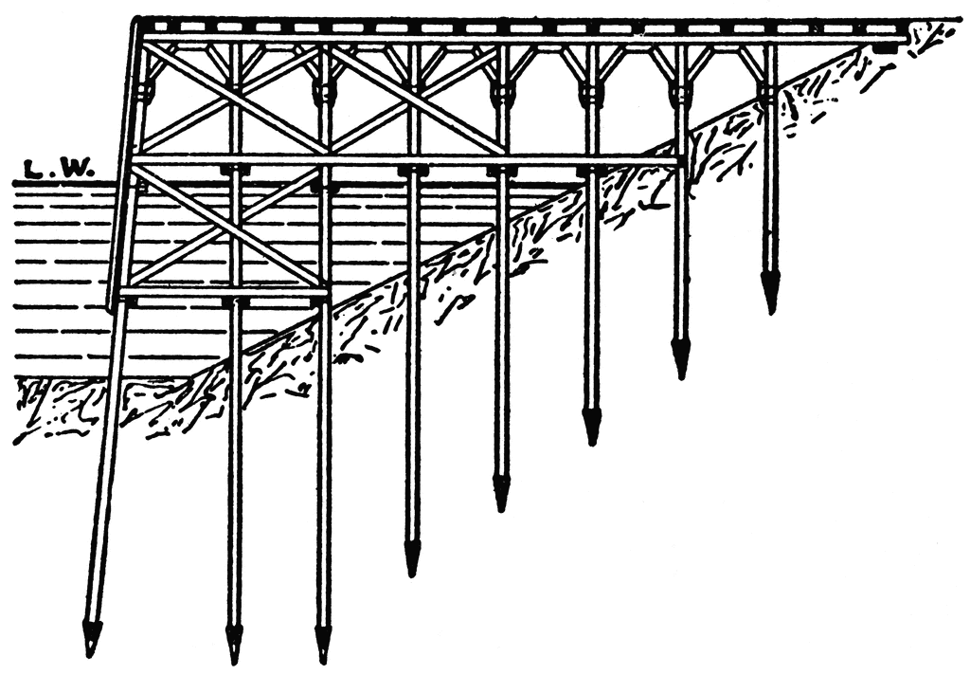
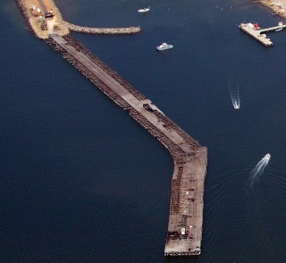
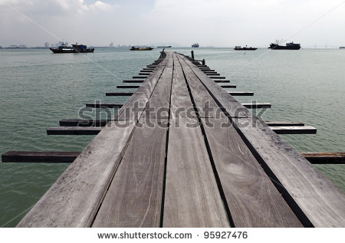

Slide 52
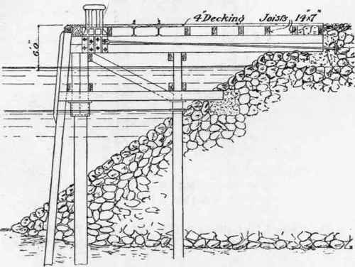
piled and cylinder jetties
Piles are completely encased in concrete cylinders
Piles carry loads of whole structure and cylinders don’t
Capable of sustaining heavy impacts from ships

Slide 53
Pier
Piers are the wharves built at angle with the shore.
On both sides of a pier berths are provided.
Type-: open or solid construction
Open pier are constructed over open water on exposed timber or concrete piles
Open pier are used where minimum restriction of currents is specified
These piers are relatively more economical as narrow piers in deep water

Slide 54
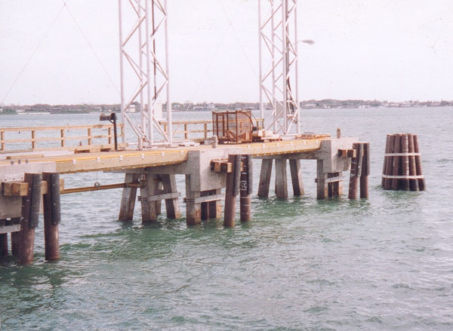
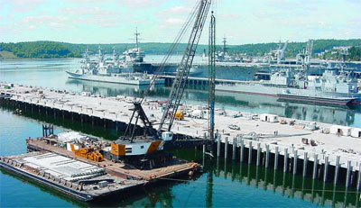
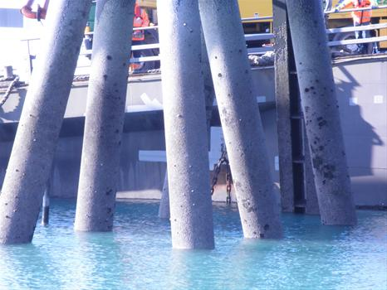

Slide 55
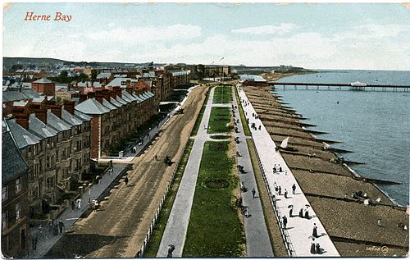
Solid piers are built of materials like earth or rock fill
It offer more resistance to impact and wave action.
More stable and more economical than open pier
the water area between two adjacent piers is known as slip
Width of slip=3 or 4 X beam of the largest ship to be accommodated
No provision should be made for cargo storage
Guidelines-: design load=30 kg/cm2, concentrated live load=5 tone truck, 15 tone locomotive crane, horizontal thrust on a pier head bent may be taken as 1% of the maximum weight of the vessel to be berthed
Solid pier

Slide 56
Pier heads
Definition-:
A pier head is a structure constructed at the tip of a breakwater near the harbour entrance.
It helps in demarcating clearly the approach channel.
It protects the breakwater section immediately adjacent to it.
It should be self-sustained and properly anchored
It is exposed on three sides and subjected to worst forces
Constructed as an independent monolith without any step or projection at its base.
Provide a vertical joint separating the pier head and breakwater.
It should be furnished with lantern or light

Slide 57
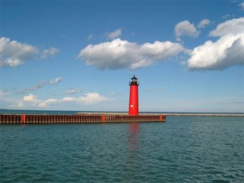

Slide 58
Dolphins
They are the marine structures located at the entrance of the locked or alongside a pier or a wharf
Uses-:
to absorb the impact force of the ships
to provide mooring facilities i.e. for tying up ships
they are also used to shorten the length of piers and wharves

Slide 59
Types-:
Breasting Type
Provided in front o the sea face of the pier of wharf.
Designed to take the impact of ship while docking and are equipped with fenders
Also have bollards and mooring post
Mooring lines provided by breasting dolphins are not sufficient enough to hold the vessel against currents away from the berth, mooring dolphin are provided

Slide 60
Mooring type-:
Located behind the seaward force of the berth
They are provided with bollards or mooring posts and with capstans where heavy lines are to be handled
Smaller than breasting dolphins
Flexible dolphin are in the form of wood pile clusters of 3, 7, 19 etc piles wrapped with the galvanized cable
Central pile extends about 1m above the other piles
The piles are arranged symmetrically and on a slight batter

Slide 61
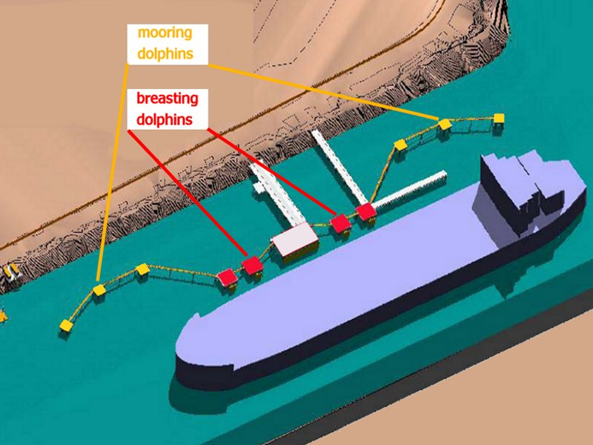

Slide 62
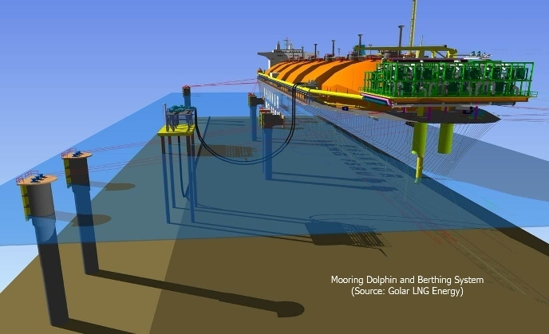
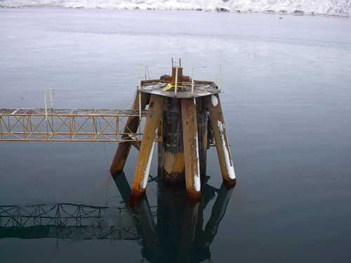

Slide 63
Fenders
A fender is a form of a cushion is provided on a pier face for ships to come in contact
The fender can be made of different materials in various forms
It absorbs the impact of ship and protect them from damage
No fenders are necessary for gravity wharves

Slide 64
Qualities of good fenders-:
they should have a high capacity for absorbing energies during berthing of a ship
they should be simple in design and construction and easily replaceable
it must be able to resist tangential forces effectively
they should not be easily damaged during berthing
They should not damage ship’s hull

Slide 65
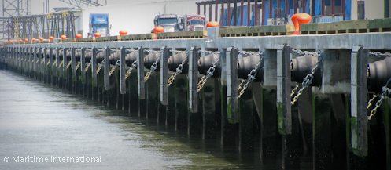

Slide 66
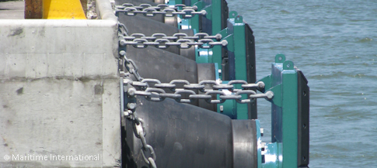
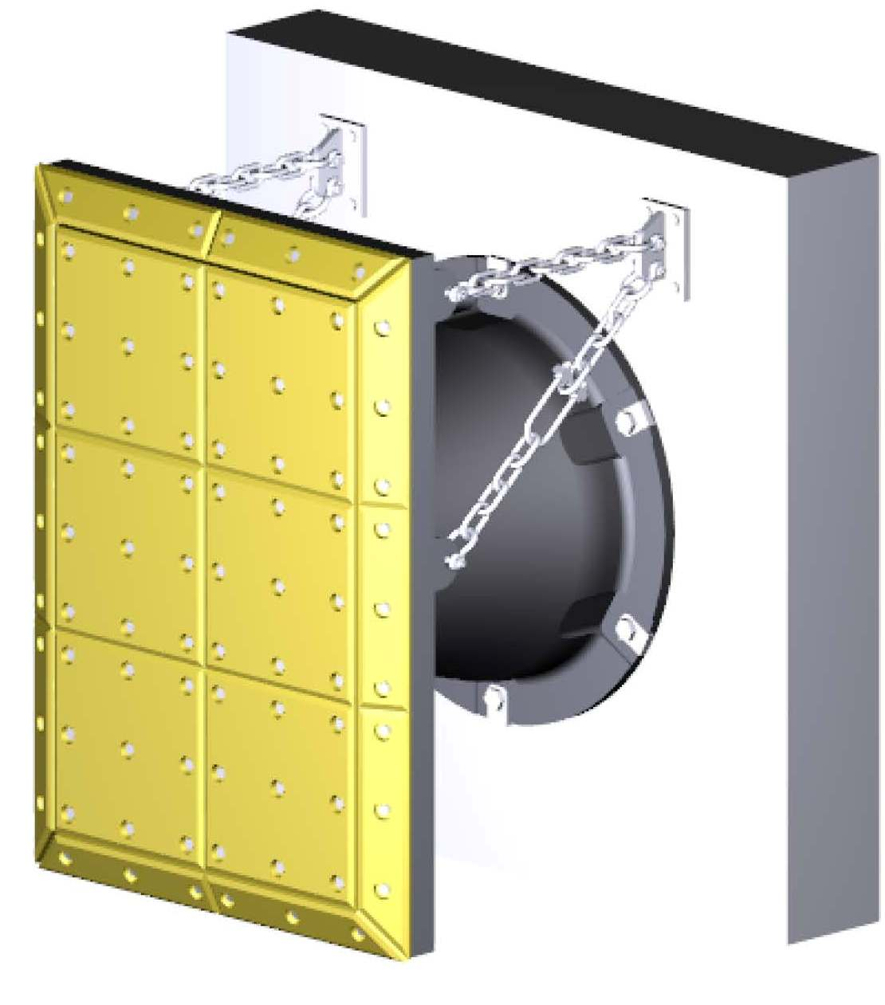

Slide 67
Types of fenders-:
Wooden fender
Simplest form of wooden fender are in the form of horizontal wooden member
Vertical wooden piles known as hung fenders are hung from the deck and terminated at water level
The wooden fenders piles are placed away from the deck on a slight batter of about 1 in 24
They absorb energy because of deflection when struck by a ship

Slide 68
Rubber fenders-
The simplest form of rubber fenders are rubber tires hung over the side of the dock
Draped rubber fenders were originally used as the hollow cylindrical type the fenders should be pre curved to the specified radius
Draped rubber fenders are supported by wire rope attached to eye bolt set in the concrete dock wall
A drain hole is provided at the lowest point of each curved fenders

Slide 69
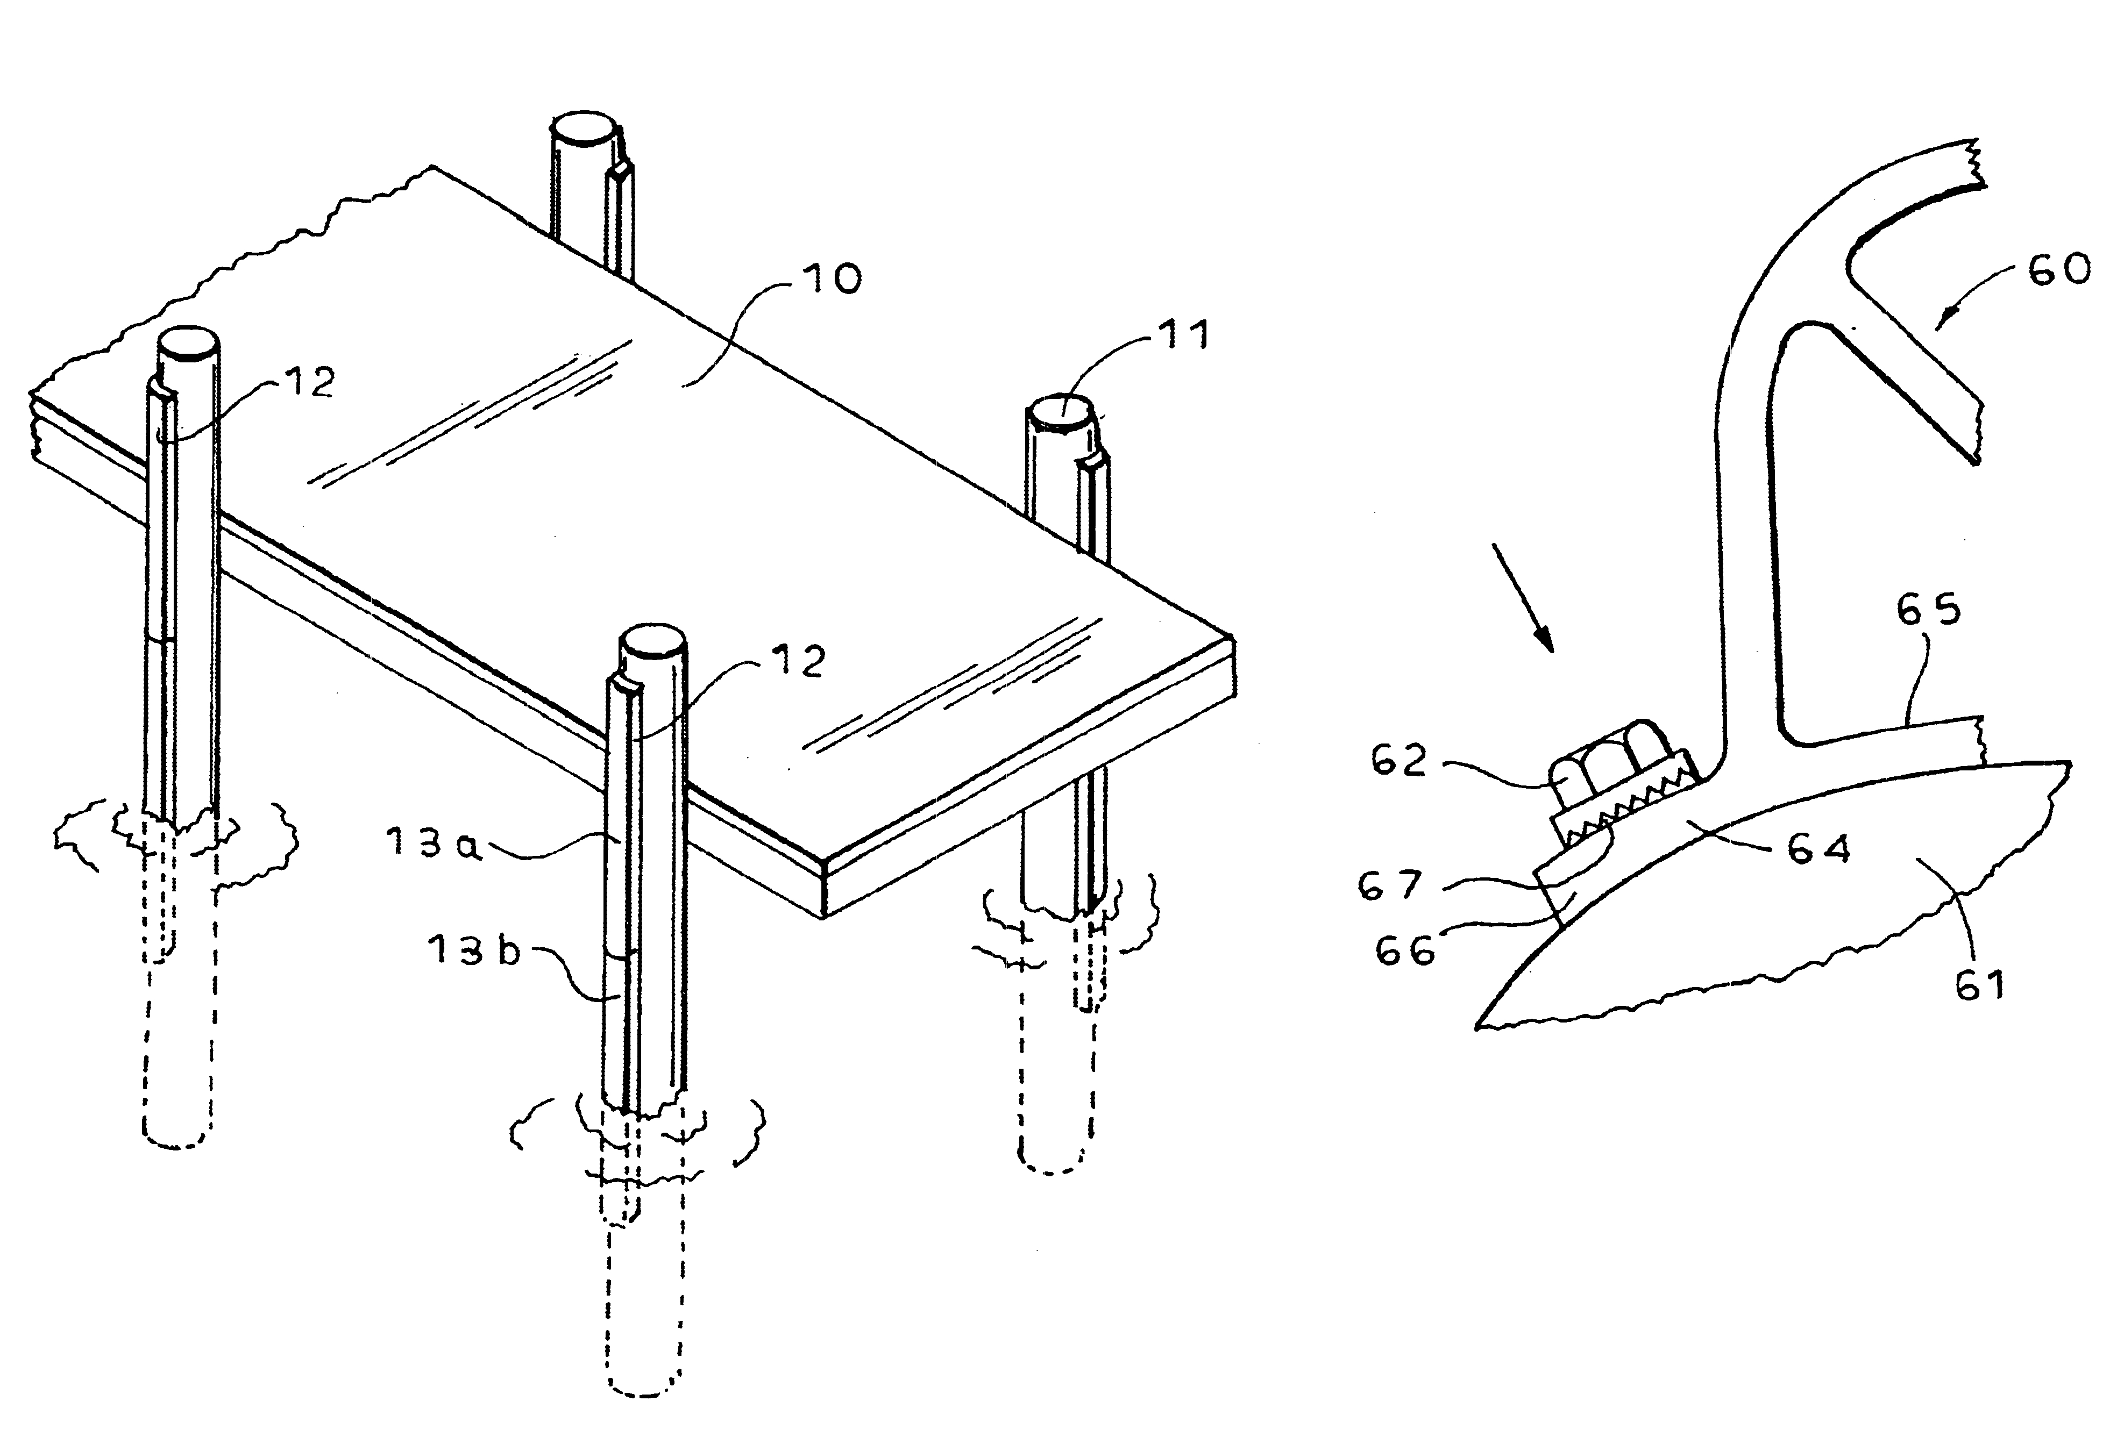

Slide 70
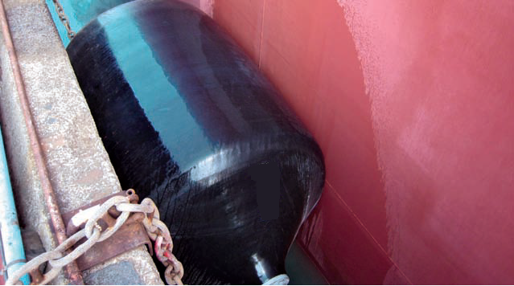
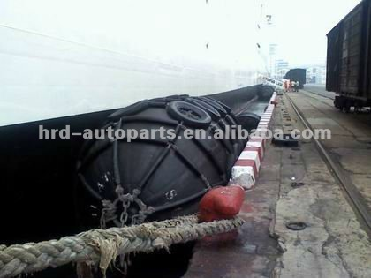
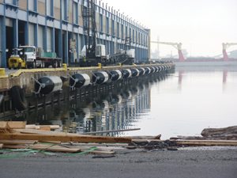

Slide 71
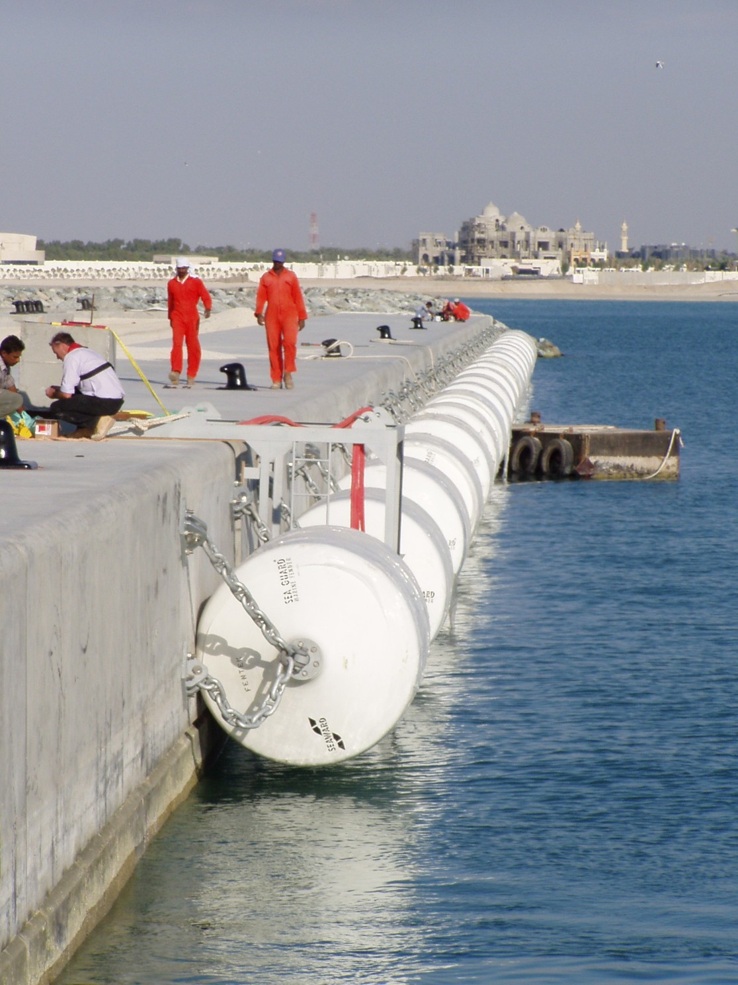

Slide 72
Mooring accessories
Arrangement such as bow, stern, spring and breast lines are necessaries to hold the ship stationary with the dock
This is done in order to load or unload the cargo as well as passenger
Mooring accessories
Bollards-
This is fastened to single or double bollards which are located along the face of the dock 15 to 27 m apart with the help of ship lines such as bow, stern lines, spring and breast lines.

Slide 73
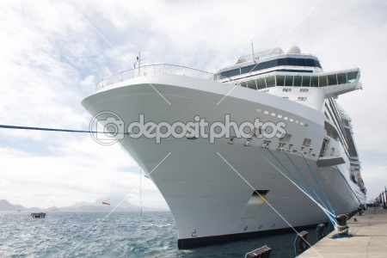
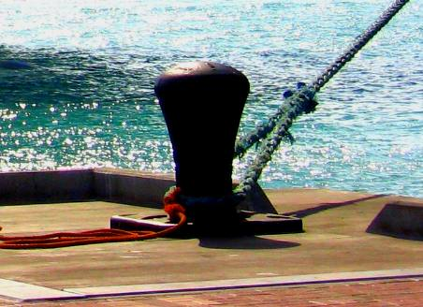

Slide 74
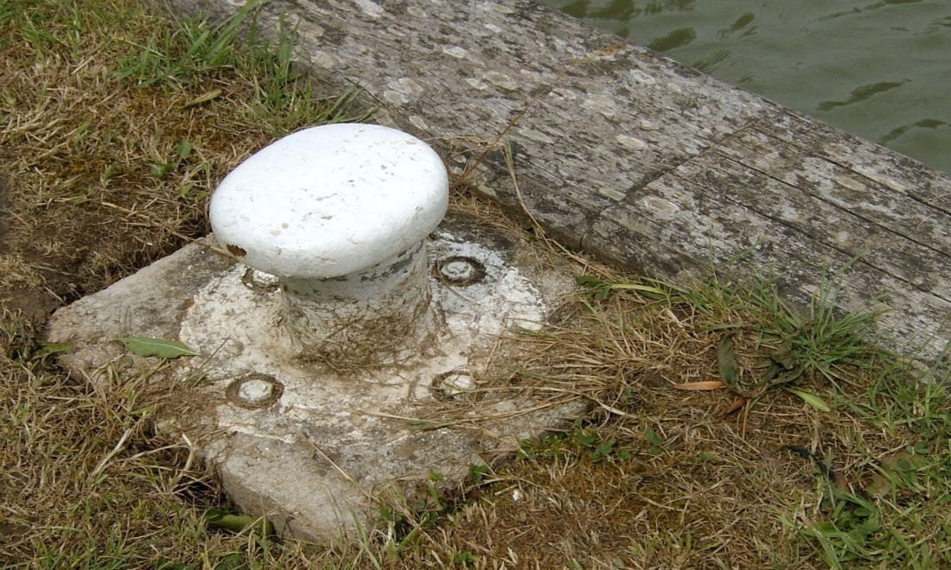
Corner mooring post-
These are located at the out shore corners of a pier or at the ends of the wharf
These posts are designed to take greater loads than that on bollards which is about 50 tones line pull
Used mainly to bring the ship into the dock or to wrap it around the corner of pier or dolphin

Slide 75
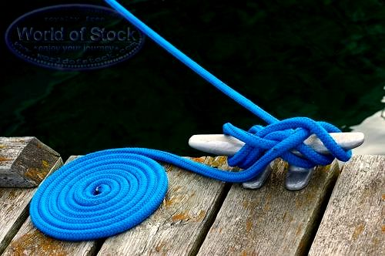
Cleats-
Cleats are used to tie small vessels such as; small ships, tugs and workboats
These are usually spaced about 10 to 13m apart along the face of the dock.

Slide 76
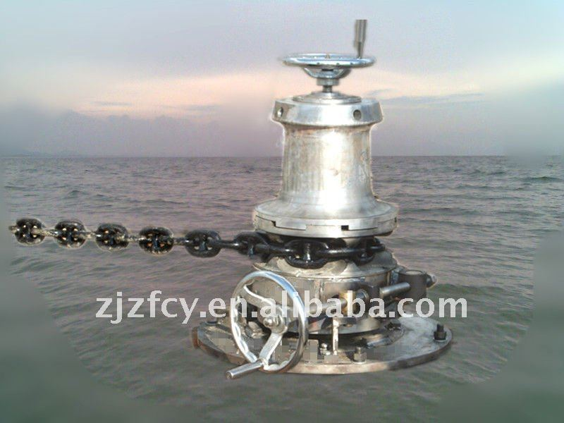
Capstans-
It has a revolving cylindrical surface
These are used to wind the ship’s line and thus to pull the ship along the docking platform after which the lines are secured to the bollards
They may be pneumatically or electrically operated

Slide 77
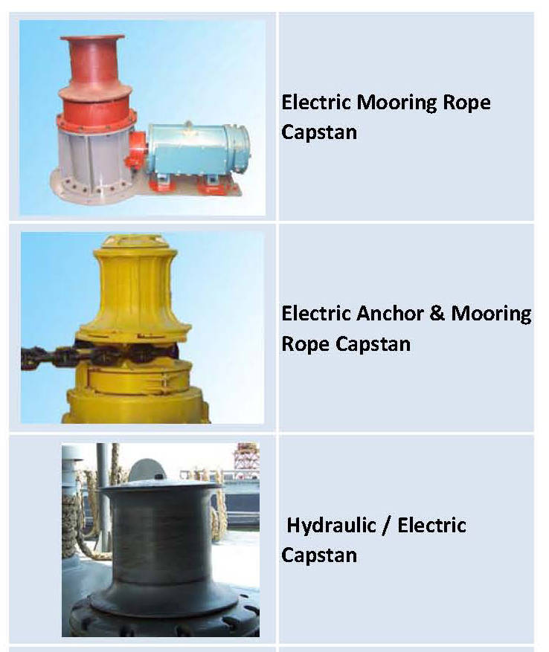

Slide 78
Site Selection For Harbour:-
    Great care ahs to be exercised at the time of making selection of site for a harbour. The guiding factors which play a great role in choice of site for a harbour are as follows:
    Availability of cheap land and construction material;
    Transport and communication facilities;
    Natural protection from winds and waves;
    Industrial development of the locality;
    Sea – bed, subsoil and foundation conditions;
    Traffic potentiality of harbour;
    Availability of electrical energy and fresh water;
    Favorable marine conditions;
    Defense and strategic aspects; etc.

Slide 79
Size Of Harbour:-
    Size of harbour depends upon the number and size of ships likely to use the harbour at one time. Some of the biggest modern ships are 275m to 300m long and about 30m wide. There should be sufficient area for maneuvering them without collision. Thus, the size is determined by:
    Accommodation required.
    Convenience for maneuvering and navigation.
    Adaptability to natural features.

Slide 80
Size Of Harbour:-
    WIDTH OF ENTRANCE TO THE HARBOUR:-
    The entrance width should be in proportion to the size of the harbour and ships using it. To reduce the wave height with in the harbour, the entrance width should not be more than that necessary to provide safe navigation and also to prevent dangerous currents, when the tide is coming in and going out.
    For Small Harbours = 90m
    For Medium Harbours = 120 to 150m
    For Large Harbours = 150 to 250m

Slide 81
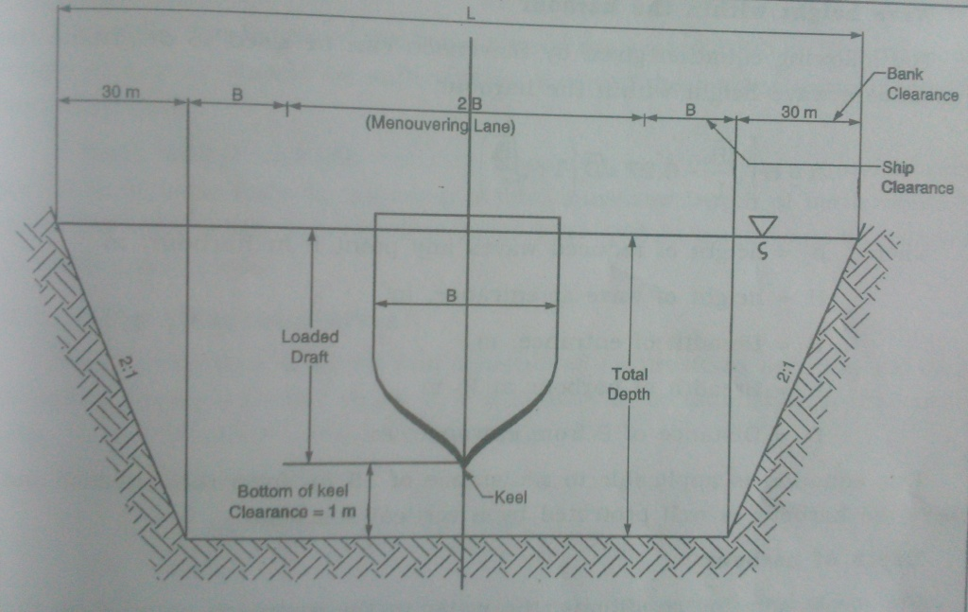
Size Of Harbour:-
    WIDTH OF ENTRANCE CHANNEL:-

Slide 82
Size Of Harbour:-
    WIDTH OF ENTRANCE CHANNEL:-
        The entrance channel width is divided into:
        Manouvering lane width = 2B
        Ship clearance lane width = B
        Bank clearance-depends on the side slopes.
    From Fig.,
    The width of entrance channel for single lane traffic,
    L = 4B + 2 (bank clearance)

Slide 83
Size Of Harbour:-
    TURNING BASIN:-
    The radius of turning basin should be equal to two times the length of the largest ship calling at the harbour.
    R = 2l
    Where, R = Radius of turning basin,
    l = length of the largest ship

Slide 84

Size Of Harbour:-
    WAVE HEIGHT WITHIN THE HARBOUR:-
    Where, h = Height of reduced waves any point P in harbour, m
    H = Height of wave at entrance, m
    B = Breadth of entrance, m
    L = Breadth of harbour at P, m
    D = Distance of P from entrance, m

Slide 85

Size Of Harbour:-
    DEPTH OF HARBOUR:-
    The channel depth is generally determined by the following formula:
    Where, D’ = The draft of the largest ship to be accommodated
    H = The height of storm waves, crest to trough
    D’’ = Allowance for squat.

Slide 86
Ship Characteristics:-
    Since harbour is designed and constructed for providing berthing and cargo handling facilities for the ships, it is necessary to be familiar with the various ship features related to harbour planning.
    LOAD LINE:-
    It indicate a line showing the water level to which they may legally be loaded.
    DISPLACEMENT LOAD:-
    The weight of ship and its contents when fully loaded with cargo to the load line is known as displacement load.
    DISPLACEMENT LIGHT:-
    The weight of ship without cargo, fuel and stores is known as displacement light.

Slide 87
Ship Characteristics:-
    GROSS REGISTERED TOUNAGE (G. R. T):-
    This is the total measured internal capacity of a ship expressed in units of 2.83 m3 or 100cu.ft.
    NET REGISTERED TOUNAGE (N. R. T):-
    This is the carrying capacity of a ship expressed in units of 2.83m3.
    DEAD WEIGHT TOUNAGE (D. W. T):-
    This is the carrying capacity of a ship by weight. It is a weight of cargo, fuel, stores, passengers, crew etc.
    D. W. T = Displacement Load – Displacement Light

Slide 88
Ship Characteristics:-
    DISPLACEMENT TOUNAGE:-
    This is the actual weight of the ship. It is the weight of water displaced when afloat and may be either loaded or light.
    DRAFT:-
    It is the depth of the keel of the ship below water level.
    CARGO TOUNAGE:-
    It is a commercial expression which forms the basis of freight charge. It can be measured by volume or weight.
    BALLAST:-
    It is the weight added in the ballast compartments of a ship to increase its draft after it has discharged its cargo an dto improve its stability.

